Slide 1
LaTeX Tables & Lab Practices (CSC 101)
Week 5
Practice

Slide 2
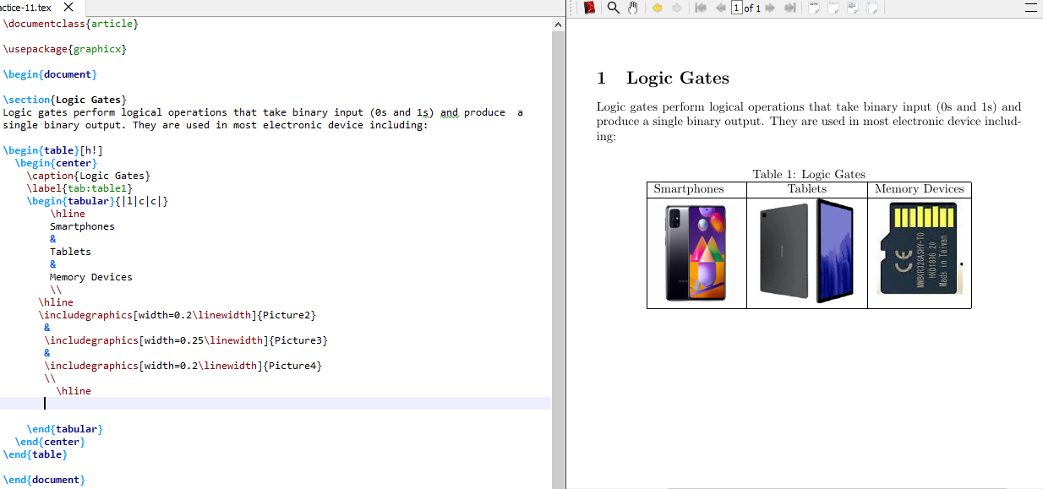
Exercise 1: Adding images to LaTeX Table
LATEX provides several options to handle images and make them look exactly what you need.

Slide 3
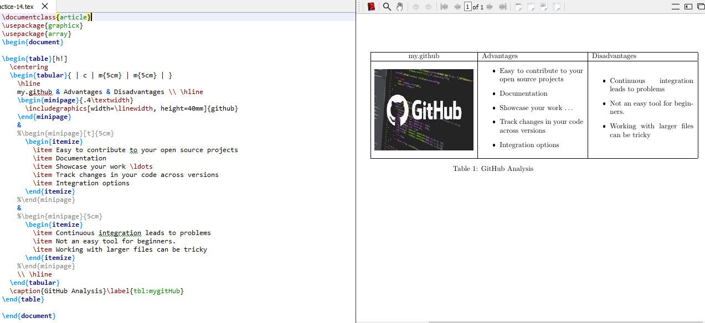
Exercise 2: Adding images to Table
The array package provides the m{<len>} column type which vertically aligns content in rows:

Slide 4
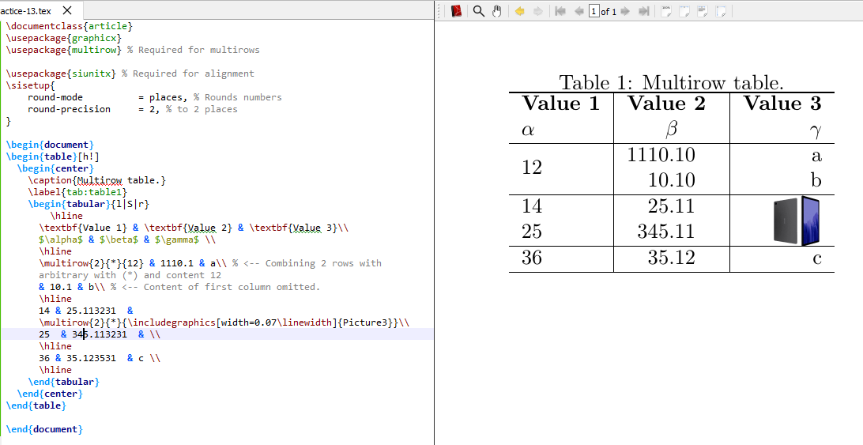
Exercise 3: Using multirow
In order for a cell to span multiple rows, we have to use the multirow command. This command accepts three parameters:

Slide 5
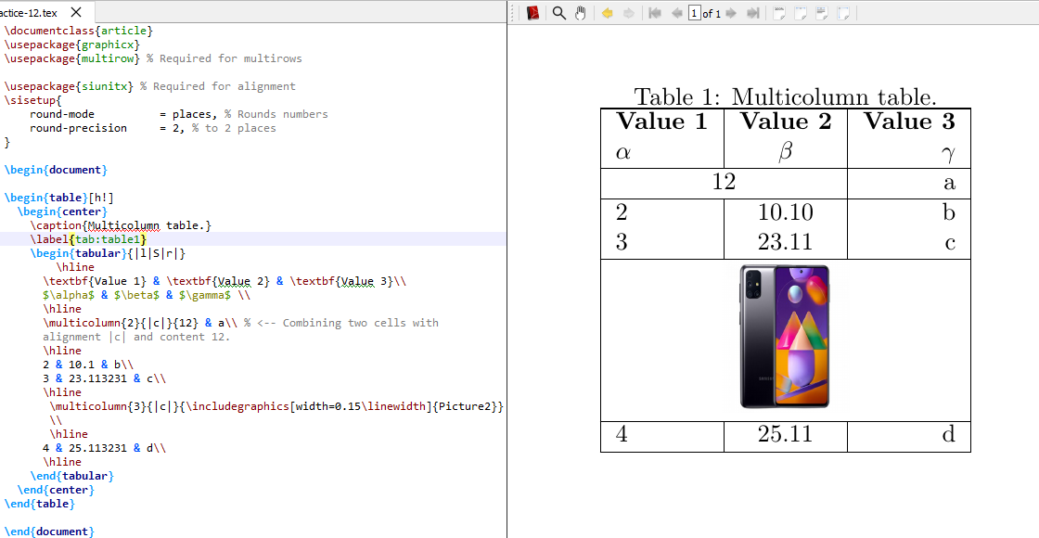
Exercise 4: Using multicolumn
If we want a cell to span multiple columns, we have to use the multicolumn command.

Slide 6
Tables from .csv in LaTeX
Syntax and usage of pgfplotstable
When writing papers, it is sometimes necessary to present a large amount of data in tables.
Writing such tables in LaTeX by hand is a very time-consuming and error-prone task.
To avoid this, we can simply import the data directly from .csv (comma-separated value) files. Programs such as Excel or OpenOffice Calc can export data sheets as .csv files.

Slide 7
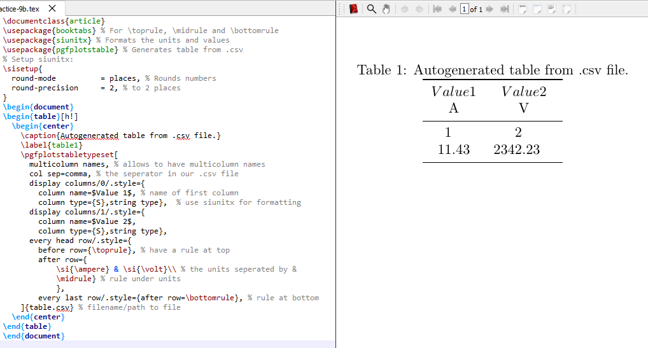
Exercise 5: Import Tables from .csv in LaTeX

Slide 8
Bibliography in LaTeX
Creating a .bib file
A .bib file will contain the bibliographic information of the document.
After creating the bibtex file, we have to tell LaTeX where to find our bibliographic database.
The commands \bibliography tells LaTeX the location of the .bib file and \bibliographystyle which selects one of various bibliographic styles.

Slide 9
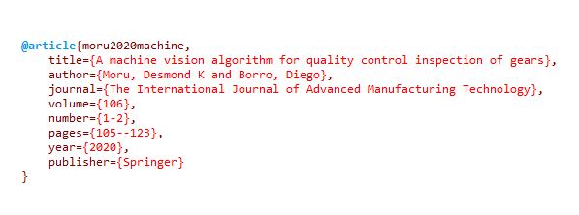
Creating a .bib file
Save as myBib.bib

Slide 10
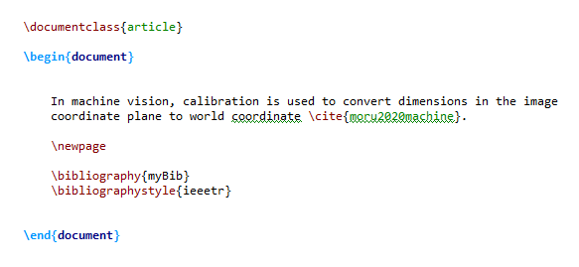
Using BibTeX

Slide 11
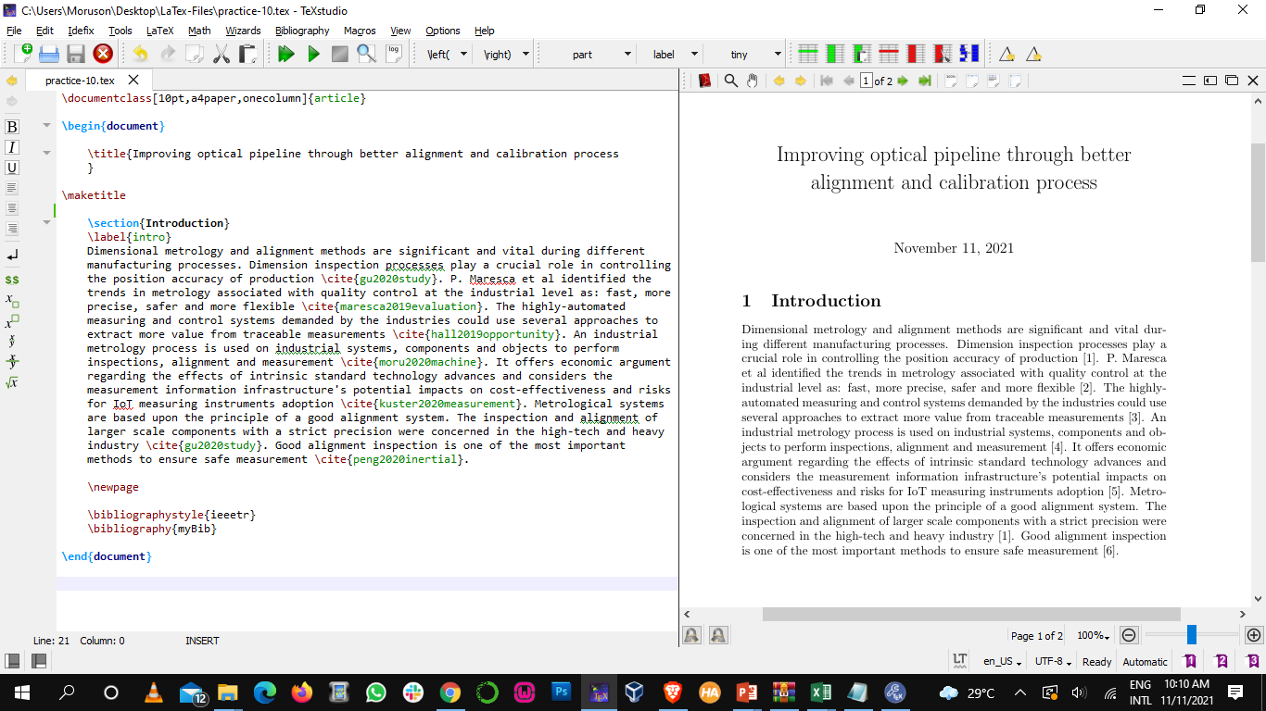
Exercise 6: Biblography in LaTeX

Slide 12
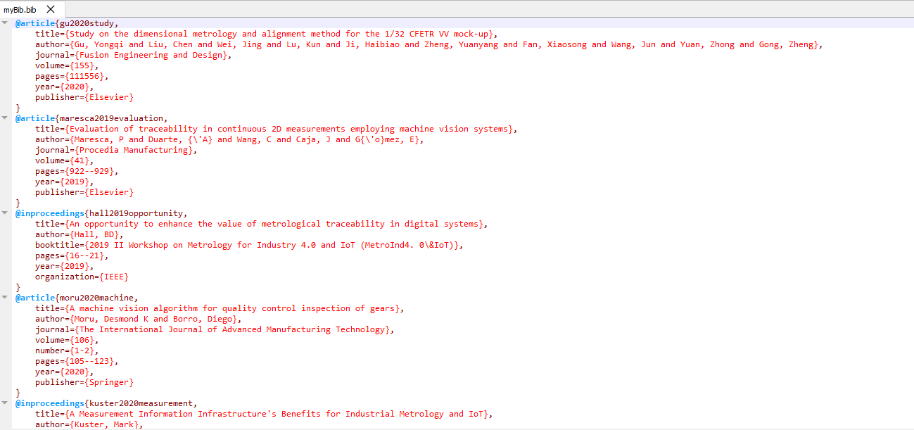
Exercise 6b: .bib file

Slide 13
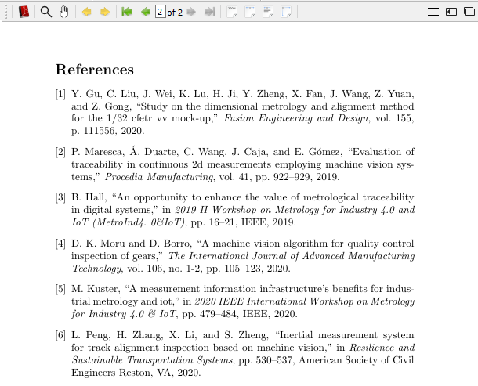
Exercise 6c: Output in LaTeX

Slide 14
Class Project I
5 Robots, named quite unexpectedly 0,1,2,3,4 are having a uniform conversation, where each of them spits out a series of 10 numbers at a time in a round-robin fashion. Your Mission, if you choose to accept it, is to develop a latex table using the pgfplotstable package. A log of a long conversation between these 5 robots has been given, this is your dataset.
The first column is source. This column gives us the label for every row of entries. The label can have value - 0,1,2,3,4. So there are 5 possible labels (the five robots.)
The features here are the sequence of 5 numbers. For each row it is num1, num2, num3, num4, num5. Thus 5 numbers.

Slide 15

Class Project II
Prepare an article for publication on GST 108 Class 3 – Logic Gates in LaTeX. Include the following:
Cover page (with title and author)
Table of content
Sections and subsections
Images
Tables (where necessary)
Bibliography

